Slide 1
PERSONAL FINANCE & INVESTMENT

Slide 2
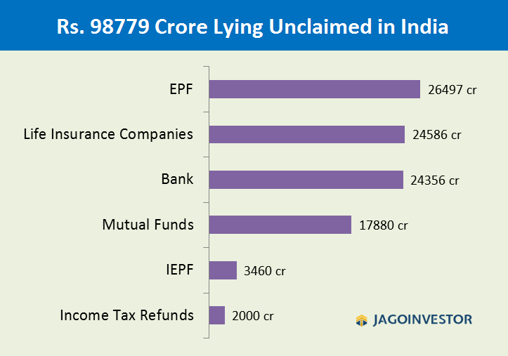
Notes:
Add you nomination

Slide 3
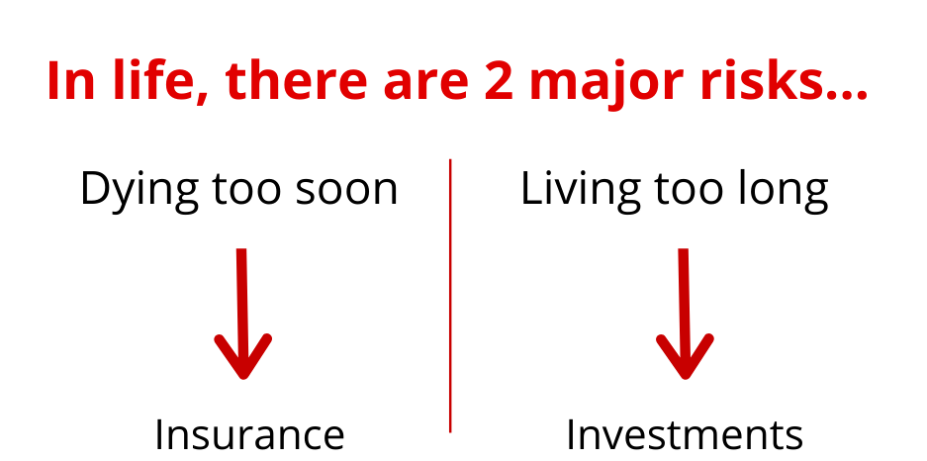
FINANCIAL PLANNING
Notes:
2 types of planning insurance n investments

Slide 4
RULES OF INVESTMENTS
Return of Capital
Liquidity
Return on Capital

Slide 5
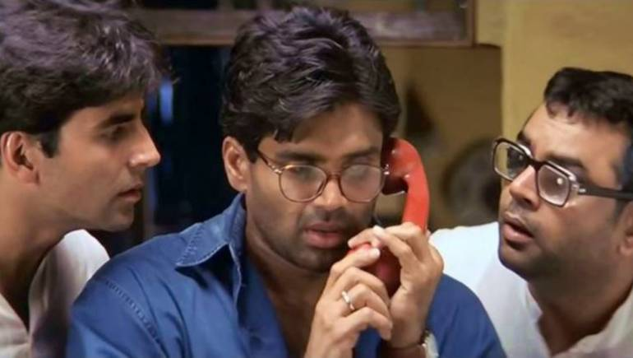
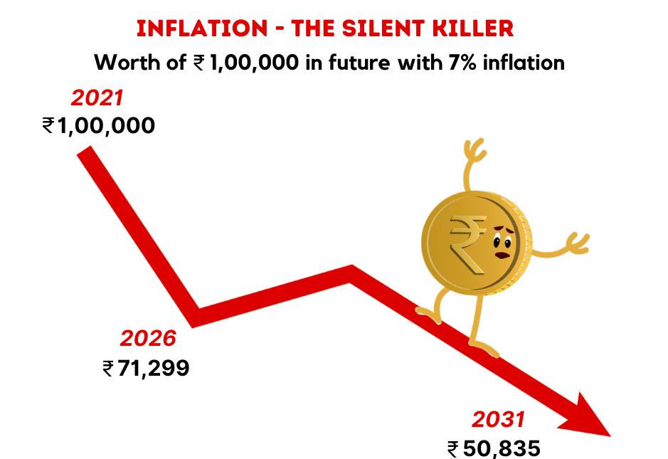
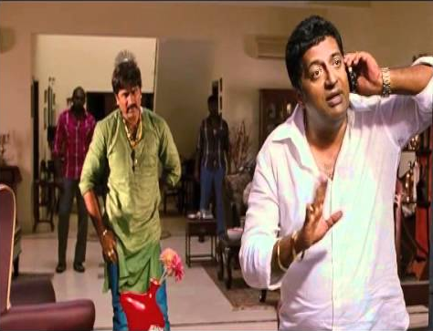
Year 2000: 20 Lacs
Year 2011: 1cr

Slide 6
INVESTMENT OPTIONS
Fixed Income
Market Linked
Fixed Deposits
Traditional Plans
Endowment/Money Back Policies
Post Office Savings Deposit
PPF
Debt Mutual Funds
Equity Mutual Funds
Shares
ULIP
Real Estate
Gold/Silver

Slide 7
FINANCIAL GOALS
Term | Time | Investment Products
Short Term Goals | < 3 years | Debt mutual funds, Fixed Deposits
Medium Term Goals | 3 to 7 years | Balanced Funds, Asset allocation funds
Long Term Goals | > 7 years | Equity mutual funds, Shares, Real Estate, Gold
Short Term
Medium Term
Long Term
Setting Bussiness / Practice
Buying 2 Wheeler
Children School Education
Foreign vacation
Buy car
Buy home(Downpayment)
Children’s education
Children’s marriage
Retirement

Slide 8
MOST IMPORTANT FINANCIAL GOAL???

Slide 9
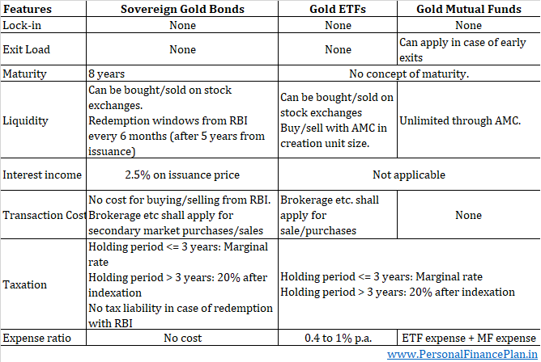
Different Investment options for Gold

Slide 10
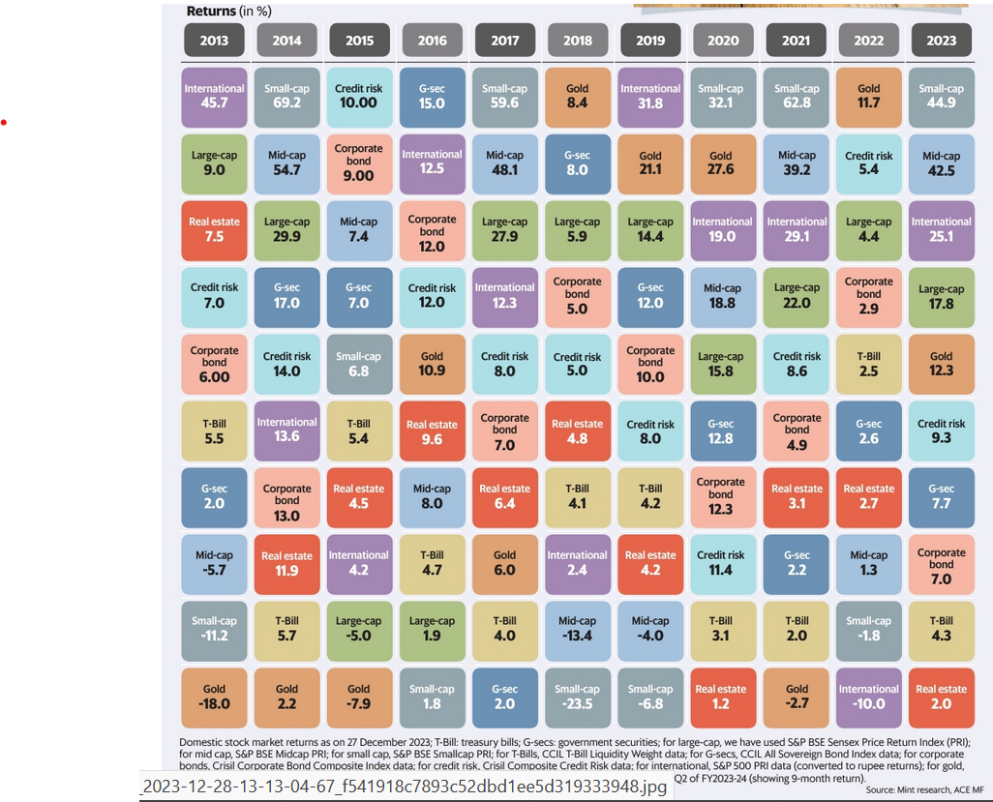
WHY DIVERSIFY?

Slide 11
WHY DIVERSIFY?
Absence of any pattern in the returns of asset classes from one year to the next. Do not predict the next winning asset class A diversified portfolio may not deliver the highest return in any given year but will perform competitively across market cycles. Exception of Small Cap in 2020 and 2021, different asset classes on top in each year Apart from 2016, Gold either ends up being amongst the best asset class in some years and worst in others. No middle way. Perfect hedge? Gold slid to bottom of table for 3 years following its run at the top and remained a laggard for 6 years No market linked product for emergency/short term Large Cap Funds a no brainer. Apart from 2015 ,large caps have always given positive returns 2020 was covid year. My March, even 40 years of experienced experts predicted doomsday. No asset class gave negative returns. Most were proved wrong. No one can predict correctly. Rebalance →→ Re allocate

Slide 12
NPS: A great retirement savings option
Regular Pension After Retirement- On maturity, you receive 60% of the corpus as a lump sum payment, and with the remaining 40%, you have to buy annuities.
Maximum Lock-in- cannot withdraw till 60
Professional Management- by the PFRDA (Pension Fund Regulatory and Development Authority)
Choice of Investments- ACTIVE AND AUTO CHOICE
Additional tax benefit - Rs 50,000 in a fy Section 80CCD (1B) over and above the Rs 1.5 lakh deduction under Section 80C.

Slide 13
Buying a Home /Renting a Home
Long term commitment
Tax benefits
Sense of stability & security
High Upfront Costs+ Maintenance
Illiquid asset
Ownership
No long term commitment
No maintenance cost
No property tax
Flexibility
No liability
No ownership

Slide 14

Still want to buy a home….????
Basic thumb rules:
Home value < 5 times post-tax income. If annual is 12lakhs than home value shouldn’t be more than 60 lakhs.
EMI should be <40% of post-tax income

Slide 15




Real Estate Myths
House prices may go up Lure of magnificent returns
of early 2000
Stocks are riskier than real estate Home is an Investment

Slide 16
How should the Risk Planning be done…??

Slide 17
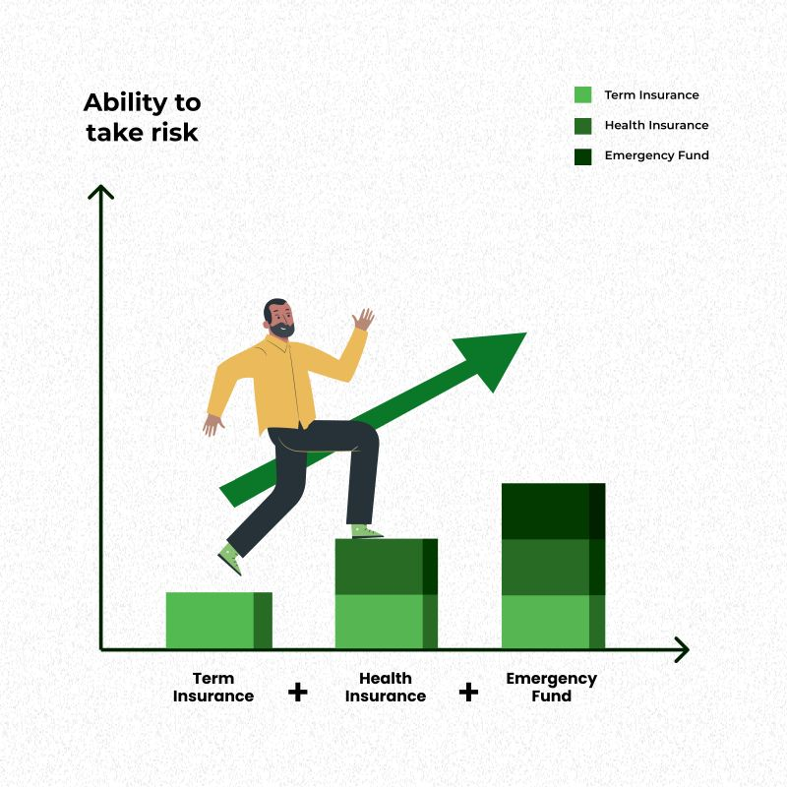
RISK PLANNING

Slide 18
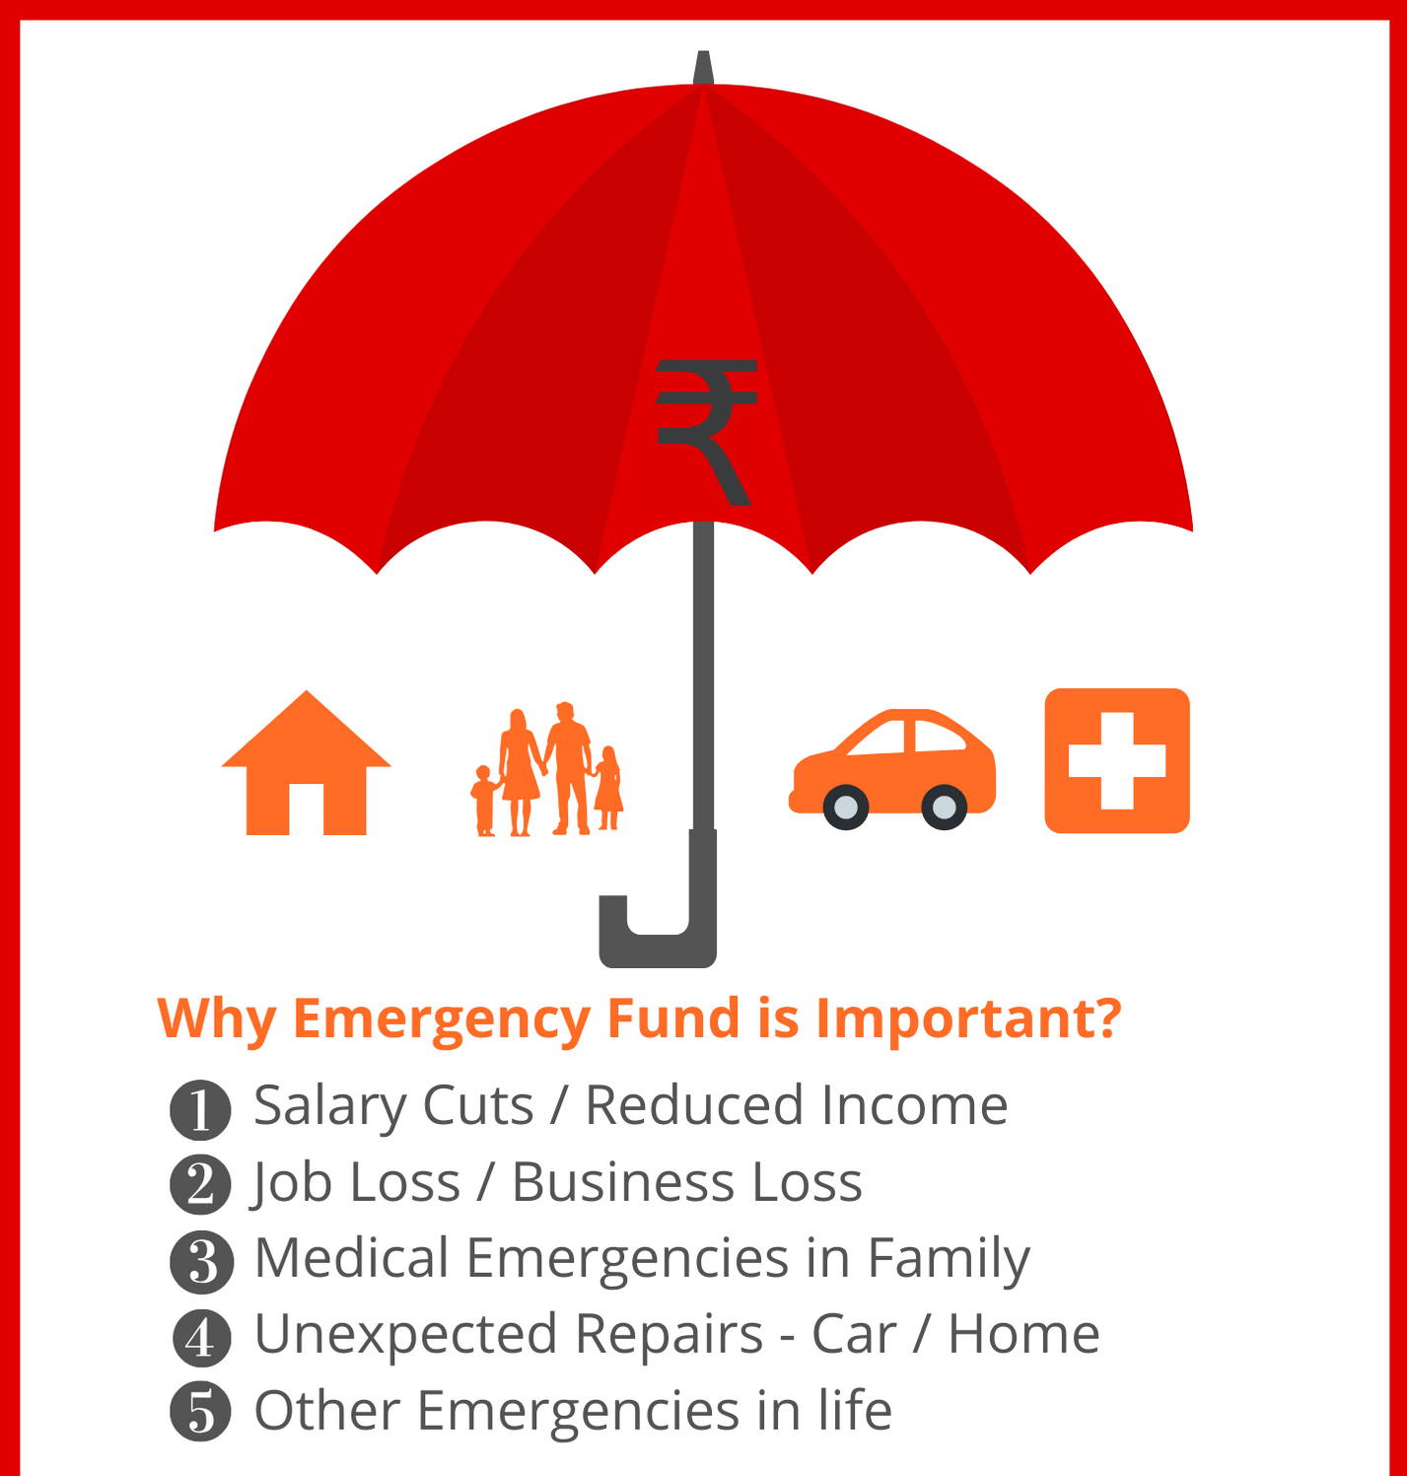

Slide 19
TERM PLAN VS TRADITIONAL PLANS
Particulars | Term Plan | LIC Jeevan Anand
Cover | 1 Crore | 1 Crore
Premium | 25,000 | 3,71,000
Surplus (Yearly) | 3,46,000 | NA
Total Premium (For 30 years) | 7,50,000 | 1,11,30,000
Corpus | ₹ 8,35,00,000 | ₹ 2.5 to 3 Crores

Slide 20
Write down the Plan
Personal Details |  |  |  |  |  | Major Goals |  |  |  |  |  | Other Goals
Particulars | Husband |  | Wife |  |  | Children's Future |  |  |  |  |  | Goal | Yes/No | Timeframe | Amount | Priority (H/M/L)
Name |  |  |  |  |  | Child-1 Name |  |  |  |  |  | International Vacation
Work Details |  |  |  |  |  | Goal | Graduation | Post Graduation | Marriage | Others |  | Car Purchase
Designation |  |  |  |  |  | Goal Age |  |  |  |  |  | House Purchase
Company |  |  |  |  |  | Current Value |  |  |  |  |  | Home Renovation
Health History |  |  |  |  |  | Or Give a Value Range |  |  |  |  |  | Holiday Home
Date of Birth (dd/mm/yy) |  |  |  |  |  | Priority (H/M/L) |  |  |  |  |  | Corpus for Start-up
Current Age |  |  |  |  |  |  |  |  |  |  |  | Family Gifting
Mobile No. |  |  |  |  |  | Children's Future |  |  |  |  |  | Charity
Email ID |  |  |  |  |  | Child-2 Name |  |  |  |  |  | Child-birth Expenses
Communication Address |  |  |  |  |  | Goal | Graduation | Post Graduation | Marriage | Others |  | Big Purchases
Retirement Age |  |  |  |  |  | Goal Age |  |  |  |  |  | Estate for Children
Life Expectancy |  |  |  |  |  | Current Value |  |  |  |  |  | Others
Family Details |  |  |  |  |  | Min-Max Range
Particulars | Child-1 | Child-2 | Father | Mother |  | Priority (H/M/L)
Name
Current Status
Health History
Financially Dependent
Date of Birth
Current Age

Slide 21
Write down the Plan
Inflows
Annual Incomes | Husband | Wife | Total
Salary Income (Take Home)
Performance Bonus (Net of TDS)
Re-imbursements
Business Income (Net Profit)
Rental Income
Investment Income
Total Income
Expected Increase in Income (%)
Outflows
Particulars | Monthly | Annual | % of Income
Food & Grocery
House Rent / Maintenance / Repair
Conveyance, Fuel & Maintenance
Medicines / Doctor / Healthcare
Electricity / Water / Labour / AMCs
Mobile / Telephone / Internet
Household Expenses
Clothes & Accessories
Shopping, Gifts, Whitegoods, Gadgets
Dining / Movies / Sports
Personal Care / Others
Travel & Annual Vacations
Lifestyle Expenses
Children's Schooling/College Expenses
Contribution to Parents, Siblings etc
Dependent Expenses

Slide 22
Investments Mistakes/Myths
Expecting Too Much returns
No Investment Goals
Not Diversifying
Focusing on the Short Term
Trading Too Much
Not revewing & rebalancing
Too many insurance policies
Taking no risk or too little risk
Investing Is Complicated
Savings Will Secure Your Future
My Provident Fund Will Take Care of Post-Retirement Life
You Must Know How To Time The Market
Buy More Funds To Diversify And Protect Downside
Buying Life Insurance is an Investment

Slide 23

THANK YOU

Slide 24
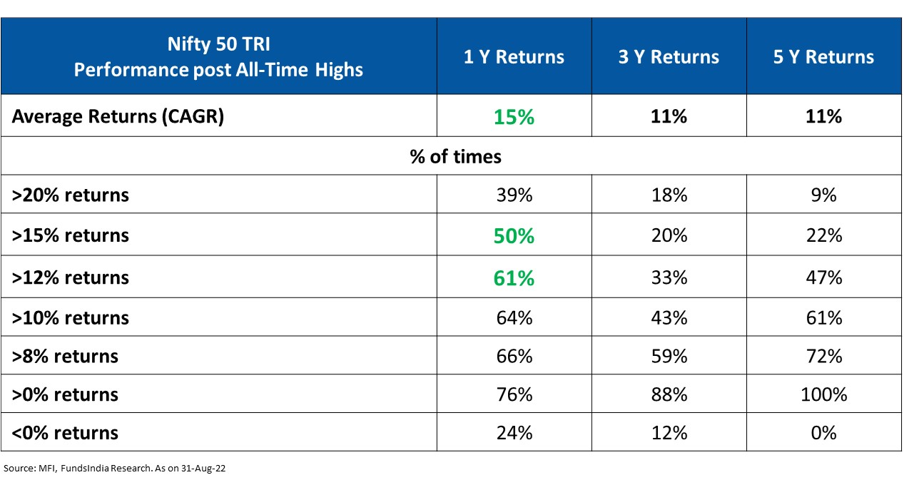
All-time highs don’t mean that markets will crash immediately

Slide 25
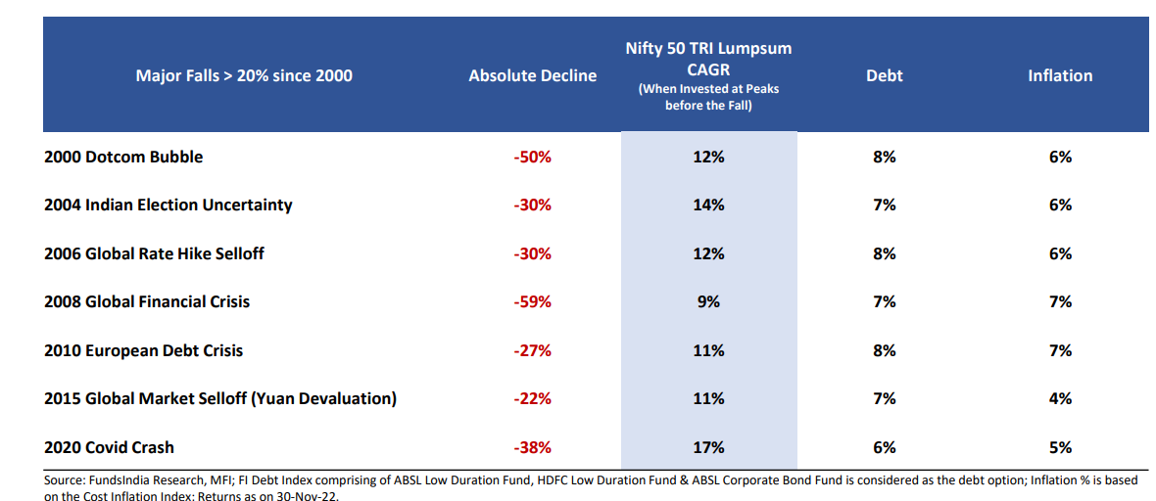
For investments made right before a market crash, returns have turned out to be decent enough IF invested for a long time

Slide 26
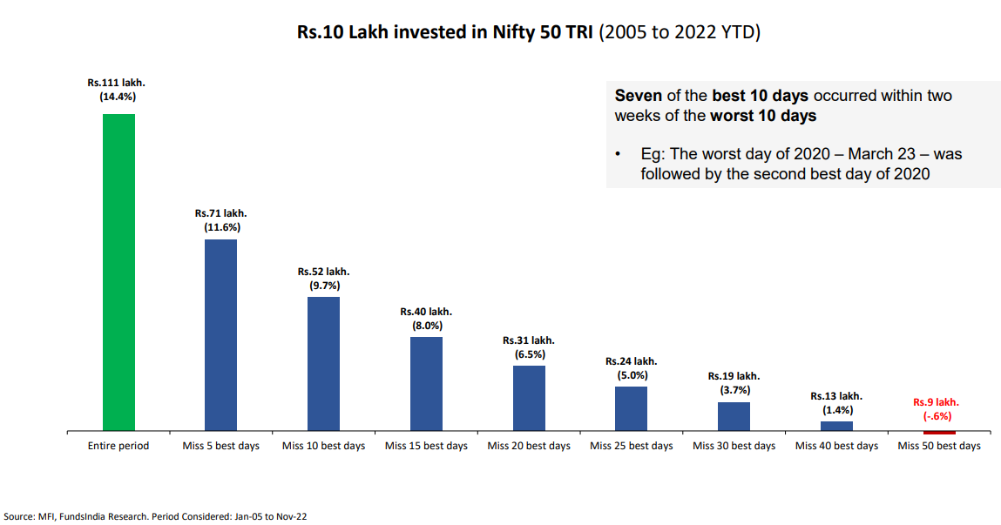
Equity Returns are non-linear - Missing few best days in the market significantly reduces returns

Slide 27

Dec 1, 2021 | Dec 1, 2022
Brent crude: $75 | Brent Crude: $ 87
USD Index: 95 | USD index: 106
US Bond Yield: 1.5 % | US Bond Yield: 3.64%
FED Rate Hikes | Nifty
1st Fed rate hike | 15692
2nd Fed rate hike | 16642
3rd Fed rate hike | 17718
4th Fed rate hike | 18053
5th Fed rate hike | 18415
2 more rate hikes | 20000??
Nifty: 17,100
Nifty: 19,000

Slide 28
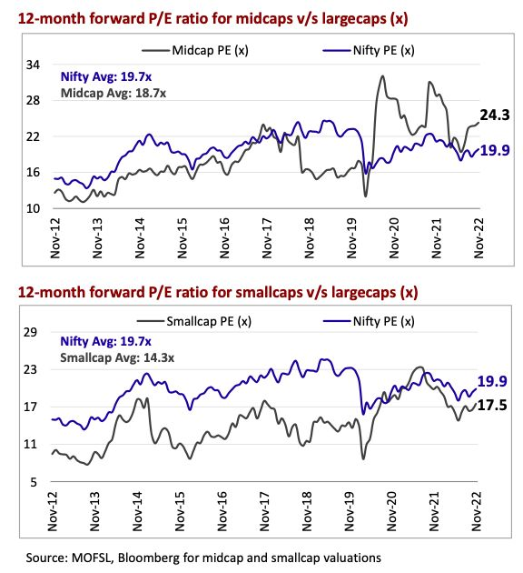

Slide 29
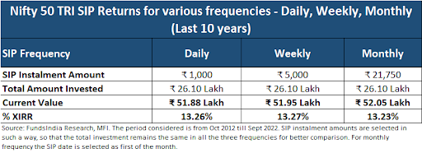

Slide 30
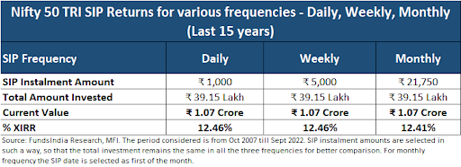

Slide 31
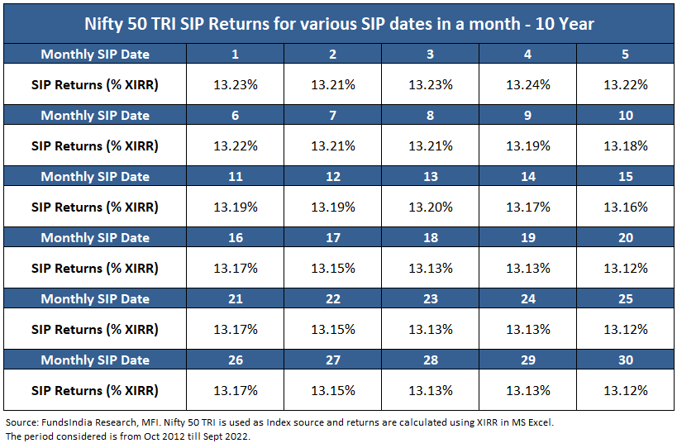

Slide 32
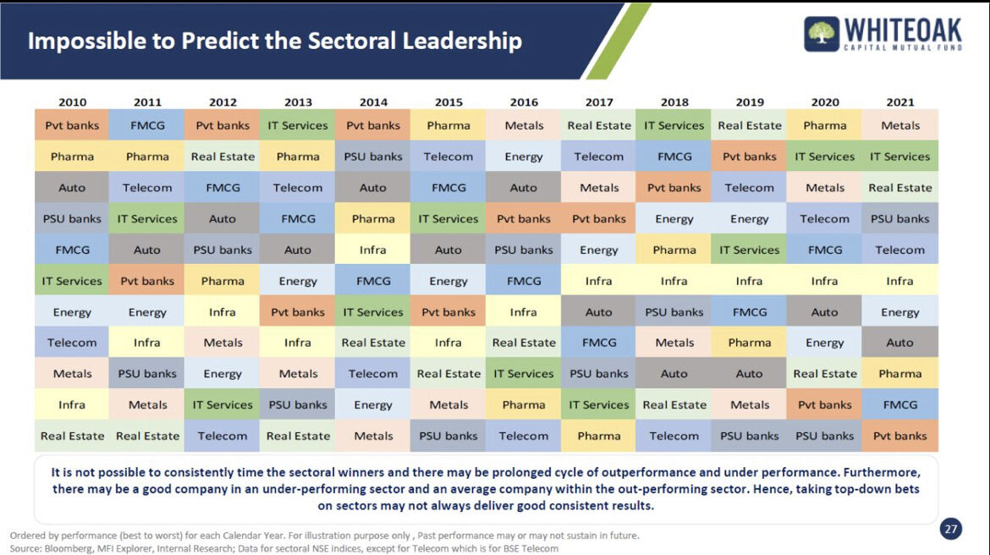

Slide 33
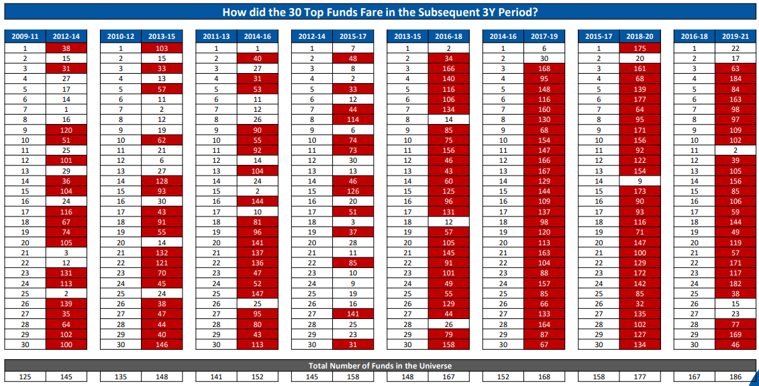
Avoid Chasing Performance – Past Winners in Equity Mutual Funds may not be Future Winners

Slide 34
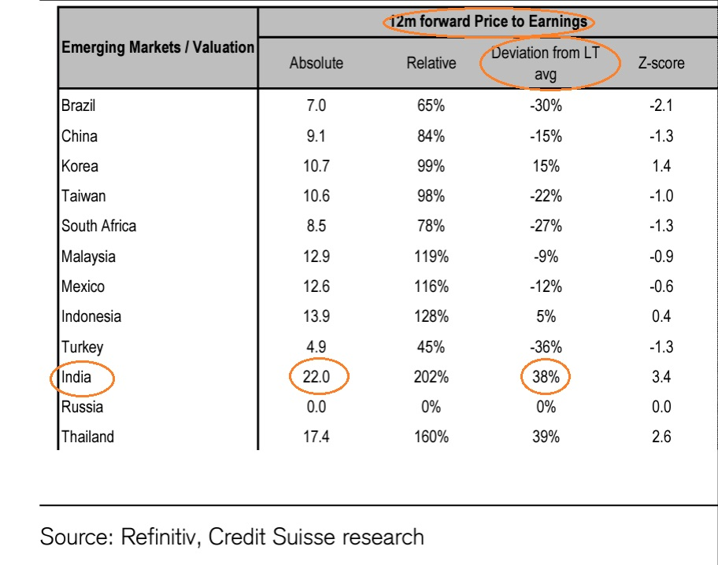

Slide 35
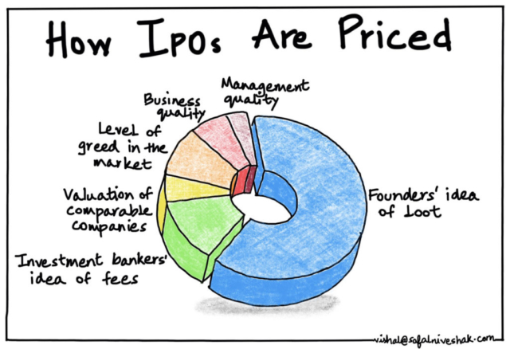

Slide 36
Best Finance Books
The Intelligent Investor
One up on Wall Street
Poor Charlie’s Almanack
The Almanack of Naval Ravikant
Thinking, Fast and Slow
The Joys of Compounding
The Psychology of Money

